Slide 1



Thoshita (aka Tosh)
Yu Ling (aka YL)

Slide 2
Overview:
Introduction
Model Selection
Gathering Data
Evaluation
Data Preparation
Conclusion

Slide 3
Introduction
Tosh.

Slide 4




Intro to our project
Emergency Meeting has been activated by Purple!
Apparently, we’ve been looking through a bunch of people for identification, and we’ve realised something off… so we’re on an investigation to find out what kind of facial shapes this set of people have!
We have one important clue, however, for the sake of this investigation: the people with more pointed faces (are more likely to be sus!

Slide 5
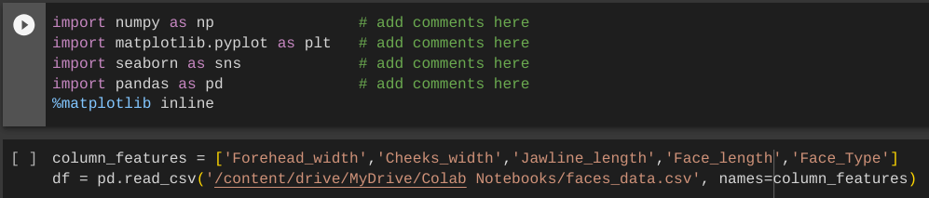
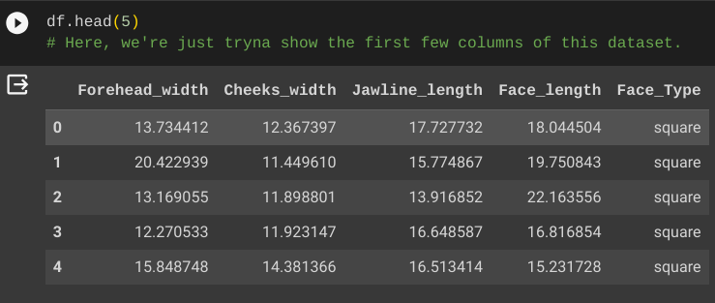

Slide 6
Gathering Data

Slide 7
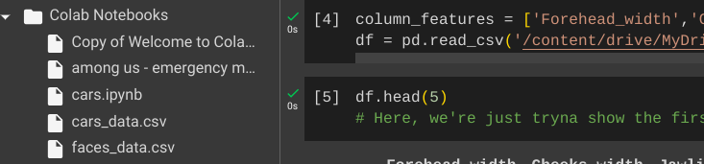

Slide 8
Data Preparation

Slide 9
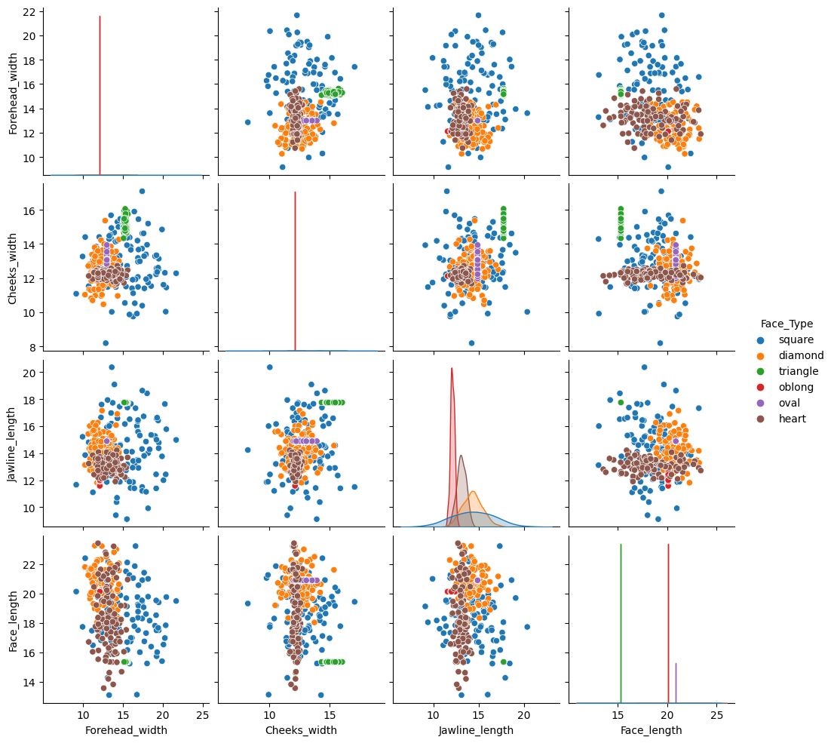
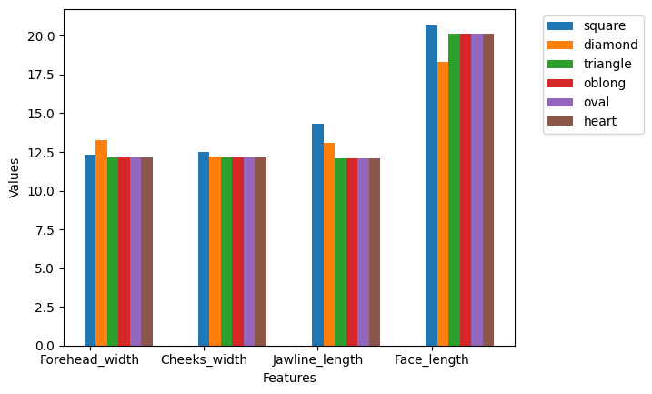

Slide 10
Model Selection
YL.

Slide 11
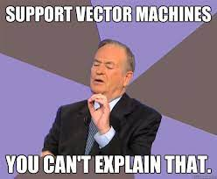
Model chosen
Support Vector Machine (SVM)
Due of its faster prediction and higher accuracy :)

Slide 12
Evaluation

Slide 13
Evaluation
Train model with SVM with 70% to train and 30% to test
then use it to predict new sets of data

Slide 14
Just to recap:
Recall
Precision
Defined as the percentage of data samples that a machine learning model correctly identifies as belonging to a class of interest.
This only applies to true positives.
Defined as the quality of a positive prediction made by the model.
This includes true and false positives.

Slide 15
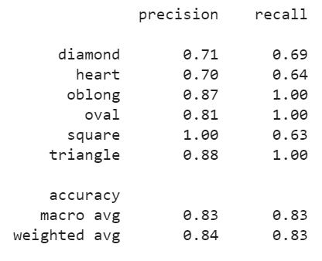
RESULTS

Slide 16
Conclusion
Spoiler alert: We learnt nothing
(jkjk)

Slide 17


Model deployed to…
Identify sus ppl based on their facial characteristics.

Slide 18
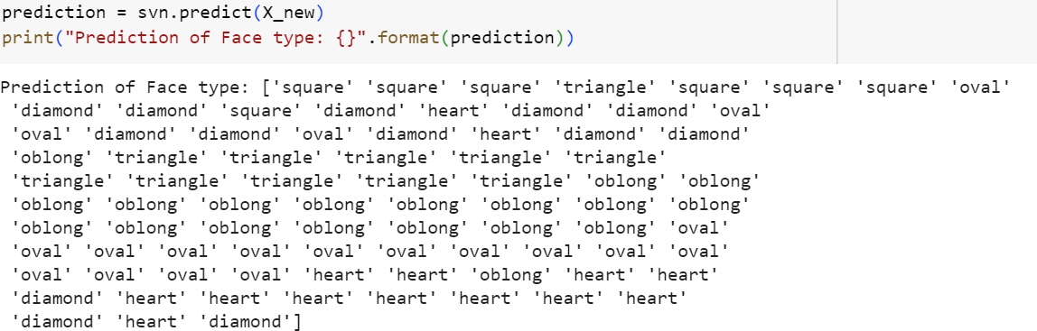
Conclusion
Top 3 is oblong (19 people), oval (19 people) and heart (14 people) :)
We’ve also found 11 people with triangle-shaped faces.
Therefore, a total 25 people have a higher chance of being sus!

Slide 19
THANK YOU!
Any questions?
Also, creds to our instructor for the data :D

